Slide 1

KJ’S EDUCATIONAL INSTITUTES
TRINITY COLLEGE OF ENGINEERING AND RESEARCH
(Accredited by NAAC with A+ Grade Approved by AICTE & Affiliated to SPPU, Pune)
Project Title:
Continuous attention monitoring in vc using media pipe and CNN
Team Members:
Siddhant Babar (CO3124) Tejas Mandhare (CO3146)
Nikhil Madle (CO3147)
Omkar Takawane(CO3109)
Project Guide:
Prof.Prasad Bhosale

Slide 2
Problem Statement
In online meetings and classrooms, it is difficult to monitor participant attention.
Manual observation is inefficient.
Maintaining attention during video conferencing is challenging, as existing systems cannot detect whether users are attentive, distracted, or drowsy.

Slide 3
Objective
Detect attention using AI.
Identify distraction and inactivity.
Send alerts to user and host.
Improve engagement.

Slide 4
Technologies Used
OpenCV (For video capture and image processing)
Deep Learning (CNN)
MediaPipe (For Facial landmark detection)
LDTN
Flask / Web App
Database

Slide 5
Working Methodology
Capture video frames
Face detection
Eye tracking & head movement
Attention classification
Alert system

Slide 6
Research Paper 1 Review
Year Author Title Methodology Advantages Disadvantages
2024 | Shreeya Patil Aayushi jani | Student’s Attention and Alertness Monitoring System using AI | Face Detection: Our attention monitoring approach is made up of a series of linked steps intended to measure attention levels in real time. Using the cv2.CascadeClassifier class, a pre-trained Haar Cascade classifier is first loaded in order to identify faces. Then, each frame of the video is subjected to the detect Multiscale method, and the resulting coordinates (x, y, width, and height) of faces that are detected are obtained. Next, we use a shape predictor from the dlib library to predict facial landmarks | 1) Real time Monitoring 2) Uses simple and efficient methods. 3) Gives useful feedback | 1) Accuracy Depends on conditions. 2) Limited to one face

Slide 7
Research Paper 2 Review
Year Author Title Methodology Advantage Disadvantage
2023 | 1)Perumal B 2)Nagaraj P 3)Thulasi Sai Narsimha Charan | Student Engagement Detection in Classroom using Deep CNN-based Learning Approach | The methodology of this paper involves collecting a dataset of around 600–1000 student images with different head poses and eye movements, which are labeled as engaged or not engaged. These images are then pre-processed through resizing and normalization to make them suitable for model training. The dataset is split into training and testing sets, and two deep learning models—CNN and MobileNet—are developed and trained on the data. The CNN model extracts features using convolution and pooling layers, while MobileNet provides a lightweight architecture for efficient processing. After training and validation, the system performs classification to predict whether a student is engaged or not based on input images. | 1) Uses deep learning models (CNN & MobileNet) which provide high accuracy in image-based classification tasks. | 1) Requires a large labeled dataset, which can be time-consuming to collect and annotate.

Slide 8
Features
Real-time monitoring
Attention scoring
3-time warning system
Host notification
Analytics dashboard

Slide 9
Expected Outcome
Automated monitoring
Attention Score Generation
Better engagement
Automated alert system

Slide 10
Applications
Online classes
Video conferencing
Employee monitoring
Smart classrooms

Slide 11
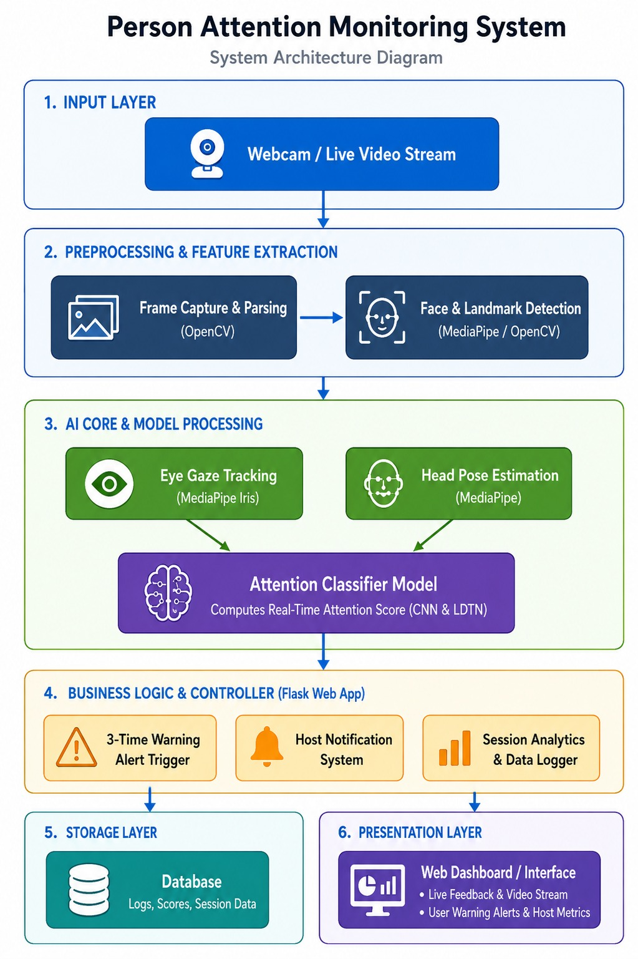

Slide 12
Advantages & Limitations
Advantages:
Real-time Monitoring
Automation
High Accuracy (Mediapipe + CNN)
Detects Multiple Behaviors
Continuous Monitoring over time
Limitations:
Lighting dependency

Slide 13
Thank You

